Slide 1
Contemporary Moral Problems
M-F12:00-1:00SAV 264
Instructor: Benjamin Hole
Email: bvhole@uw.edu
Office Hours: everyday after class

Slide 2
agenda
No Clicker Quiz
Discuss MacKinnon
Finish main argument
Discuss MacKinnon and Freedom of Speech (Objection/Response)

Slide 3
“Pornography, Civil Rights, and Speech”
Catharine MacKinnon

Slide 4
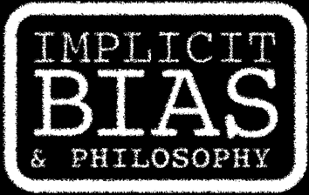
http://www.biasproject.org
For Mackinnon, what is wrong about pornography is subordination, i.e., that it promotes immoral power dynamics by perpetuating the degradation or marginalization of women.
Social identity is not something that is innate, but constructed, and pornography perpetuates oppressive hetero-normative gender roles.

Slide 5
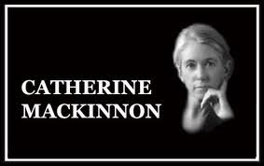
Feminism
“Feminism is the discovery that women do not live in this world [of relative equality], that the person occupying this realm is a man, so much more a man if he is white and wealthy.”
The world is structured by privilege
“Male” is the privileged gender

Slide 6
Pornography
http://videos.huffingtonpost.com/women/catharine-mackinnon-turning-point-517647556
“… sexualizes rape, battery, sexual harassment, prostitution, and child abuse; it thereby celebrates, promotes, and authorizes them.”
“Through this process, pornography constructs what a woman is as what men want from sex.”
“Women’s desire to be fucked is equal to men’s desire to fuck women.”
“It eroticizes hierarchy, it sexualizes inequality.”

Slide 7
Pornography sexualizes inequality
Strongly Agree
Agree
Somewhat Agree
Neutral
Somewhat Disagree
Disagree
Strongly Disagree

Slide 8
The Harm of Pornography
“If we see that men relate to women in a pattern of who they see women as being, and that forms a pattern of inequality, it becomes important to ask where that view came from or, minimally speaking, how it is perpetuated or escalated.”
“Recent experimental research on pornography shows … measurable harm to women through increasing men’s attitudes and behaviors of discrimination in both violent and nonviolent forms.”

Slide 9
The Harm of Pornography
“… is the harm of civil liberty of the sexes made invisible as harm because it has become accepted as the sex difference.”
“If you see Black people as different there is no harm in segregation; it is merely a recognition of that difference.”

Slide 10
The Harm of Pornography
Strongly Agree
Agree
Somewhat Agree
Neutral
Somewhat Disagree
Disagree
Strongly Disagree

Slide 11
Ronald Dworkin: “Two Kinds of Liberty”
The pro-censorship feminist arguments in question can be understood as appealing to women’s positive liberty to participate equally with men in community.
The idea, then, is that the positive liberty in question ought to limit the negative liberty of free speech and expression when it comes to pornography.
R. Dworkin instead argues that even if pornography interferes with women’s positive liberty to participate in political processes, this would not justify censoring pornography.

Slide 12

Free Speech Objection?
MacKinnon’s Response
“Any system of freedom that does not address a problem where the free speech of men silences the free speech of women … is not serious about securing freedom of expression in this country.”
“Pornography is not free speech for women, it is the silence of women.”

